Slide 1
Shallow Fermionic Shadow
Bian Kaiming
Collaborate:
Manhong Yung and Bujiao Wu
2024.3.1

Slide 2
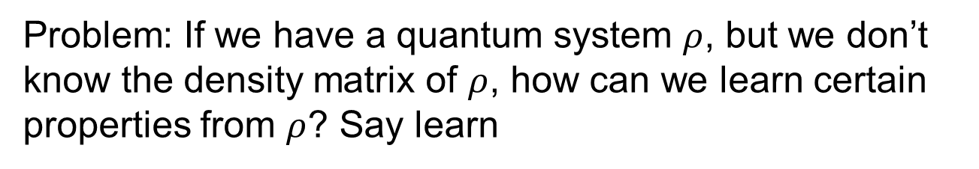

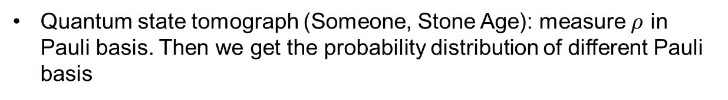
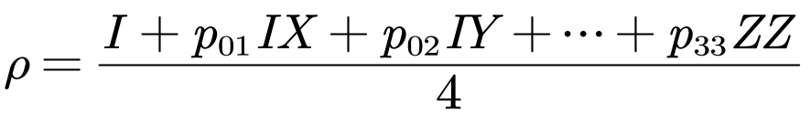
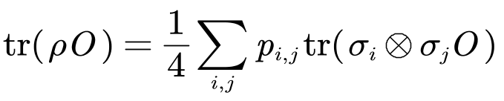
Motivation:
Readout properties from quantum system
Defect: The sample complexity scales exponential.

Slide 3
Classical shadows:
A way out of exponential
Classical shadows (Huang):

